Slide 1
PRESENTATION ON “MOVIE TICKET BOOKING SYSTEM”
PRESENTED BY:
BIRAT THAPA
RESHA MUNIKAR
SUBIKA KARKI

Slide 2
INTRODUCTION
Movie Ticket Booking System is based on C++ programming language.
It is a simple console application which allows user to book ticket and admin to handle data.
It is divided into two sections : Admin and User

Slide 3
FEATURES
Admin Functions :
Admin part is password protected.
Add new movies and its details.
View movie list.
Delete movie.
View reserved movie list.

Slide 4
FEATURES
User Functions :
View movie list and its details.
Book tickets.
Cancel tickets.

Slide 5
OBJECTIVES
Main objectives :
To help user book ticket in advance.
To help user get information about ongoing movies.
To help admin to add, delete movies in system.
To help admin get information about tickets reservation.
To keep the data of the customer who booked the movie tickets.

Slide 6
OBJECTIVES
General objectives :
To implement the knowledge gained while studying C++ programming language.
To gain a deeper comprehension of libraries, functions, the manipulation of files, and various programming concepts.

Slide 7
CONCEPT USED
CONCEPT
USED
Switch case
Function
Class
Inheritance
Object
File handling
Control flow statement

Slide 8
SYSTEM REQUIREMENTS
Following hardware and software requirement should be met for flawless running of this system:
RAM: Generally, a minimum of 32MB is recommended for the better function.
Hard Disk: The minimum storage capacity should be around 32 MB.
OS: Any OS that support the SMS. (Windows, Linux , MAC).
Applications: Dev C++ or another C++ compiler.

Slide 9
MERITS
Less time consuming
User friendly
Cost saving
Can purchase the tickets in advance
Data storage

Slide 10
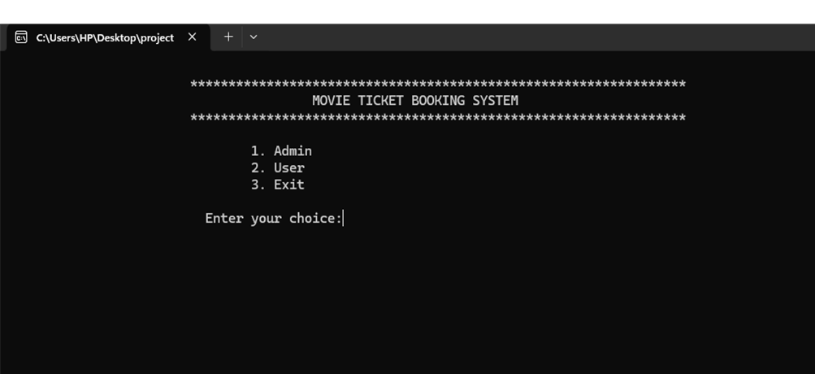
SCREENSHOTS
Main Menu

Slide 11
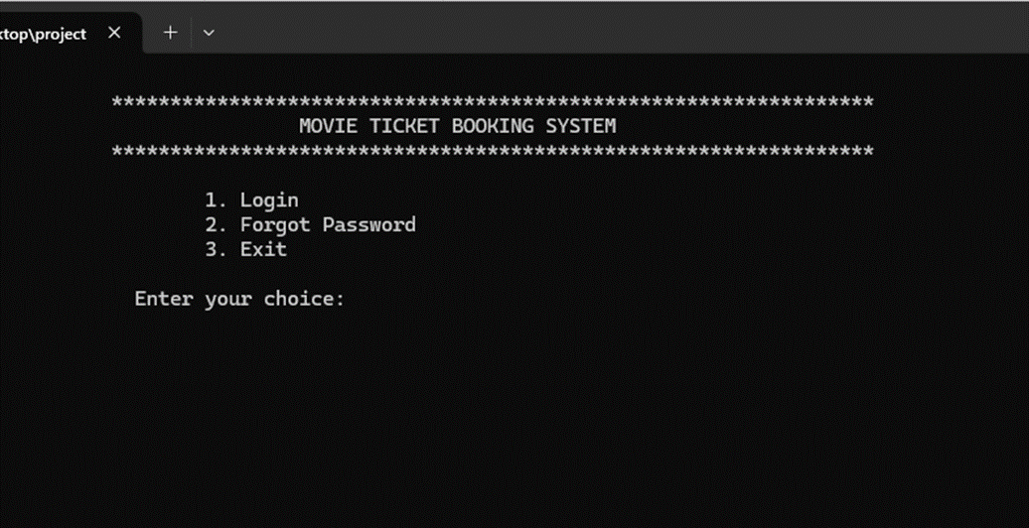
Admin’s Option

Slide 12
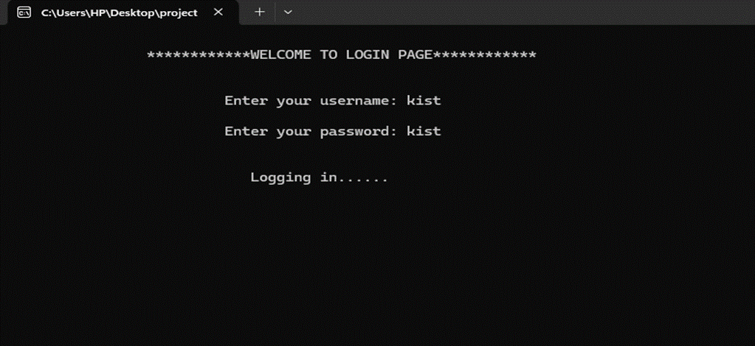
Login Page

Slide 13
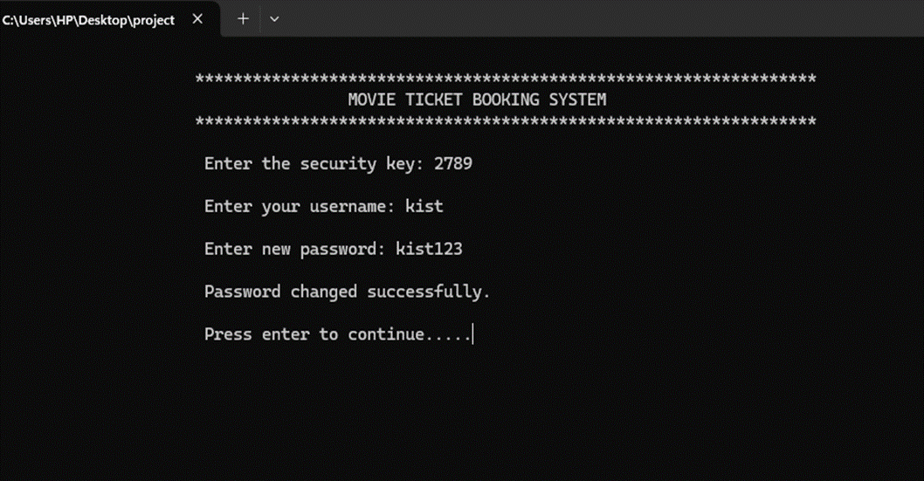
Forgot Password

Slide 14
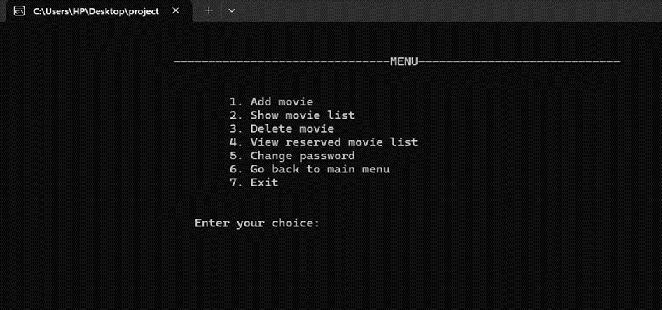
Admin’s Menu

Slide 15
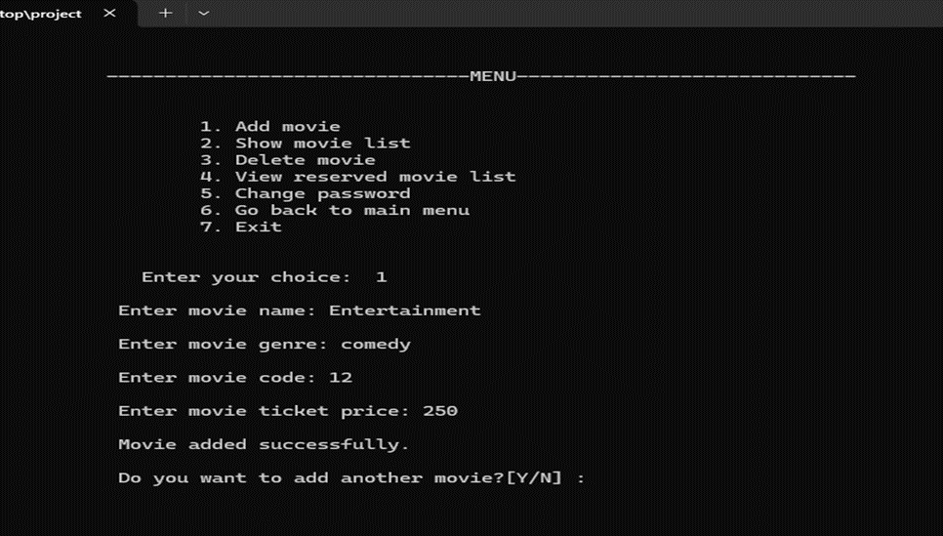
Adding Movie

Slide 16
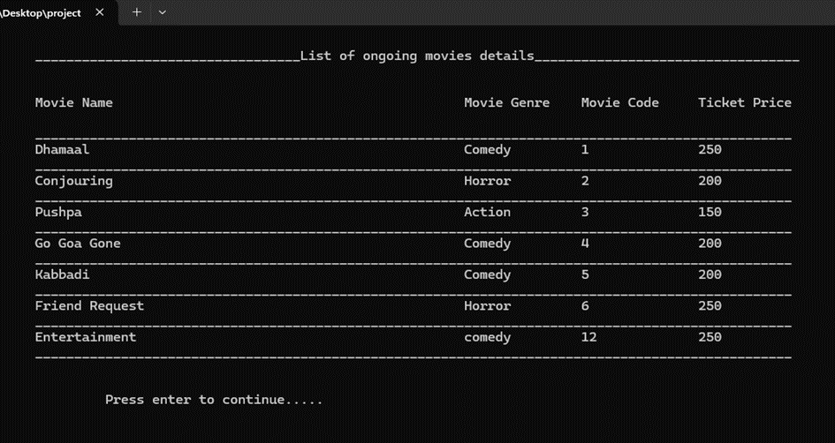
Movie List

Slide 17
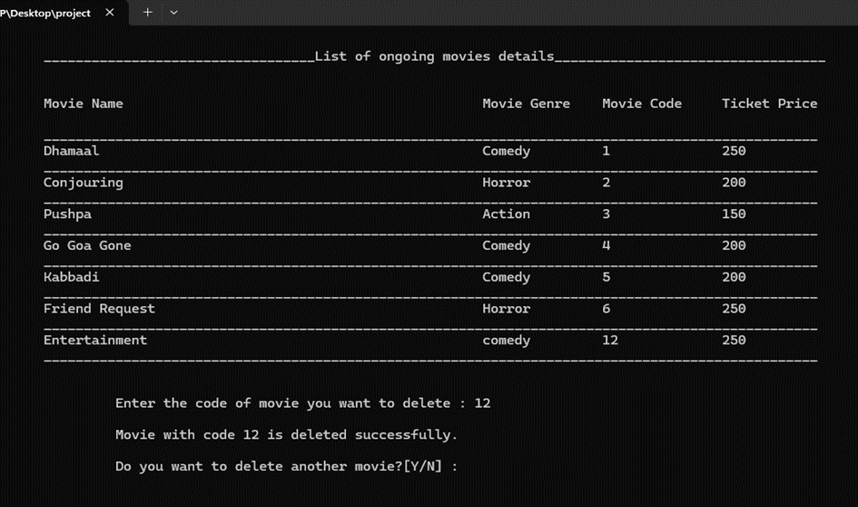
Displaying Movie List

Slide 18
Deleting Movie

Slide 19
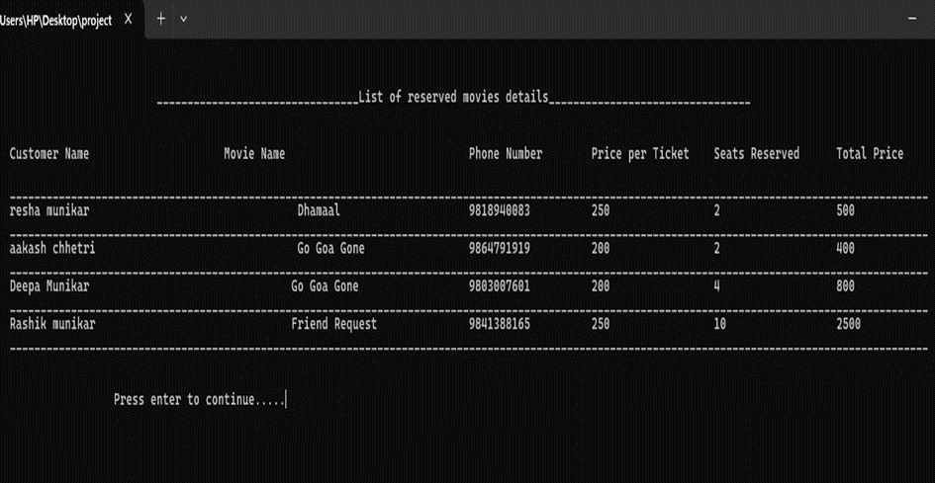
List of Reserved Seats

Slide 20
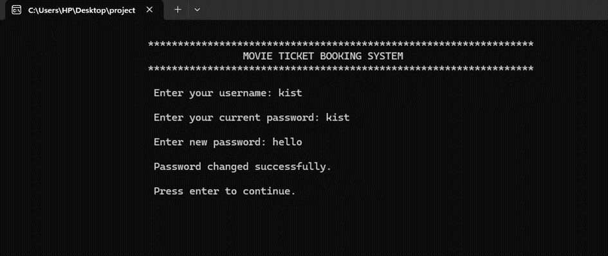
Changing Password

Slide 21
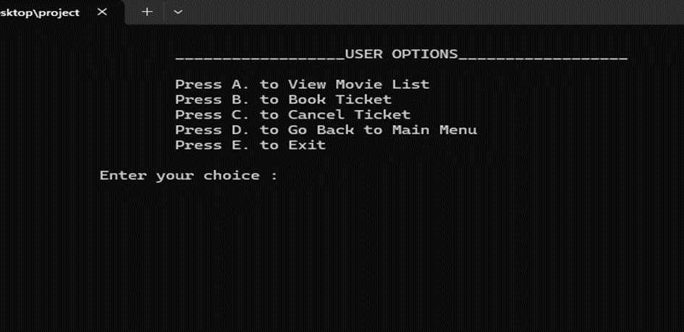
User’s Menu

Slide 22
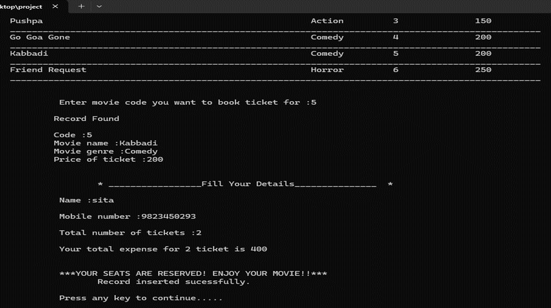
Booking Ticket

Slide 23
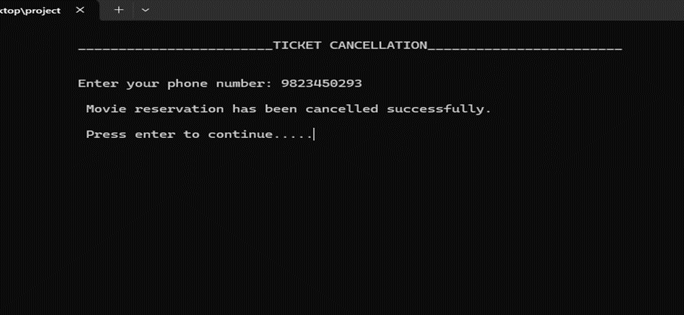
Canceling Ticket

Slide 24
FUTURE PROSPECTS
Making the Software as a Web application such that the program can be used anywhere and anytime.
We can also make the project more attractive by introducing Graphical user Interface.
Allow customer to provide review on movies.
SMS notification after the ticket is booked successfully.
Addition of downloading feature where customers can download their transaction details.

Slide 25
CONCLUSION
C++ is a basic and oldest programming language. Even though we were able to manage the system that helps user to book ticket and admin has the access to add, remove and see the reserved file, we can’t deny the fact that C++ alone can’t be used to solve modern problems. There are many limitation. In result although in concept application is good, practically creating it through old programming language like C++ isn't practical. However, it helps us boost our knowledge regarding programming languages.

Slide 26
REFRENCES
Group discussions
Class notes and suggestions from teachers
https://www.youtube.com/watch?v=1T6GDrkf6Y4&ab_channel=RajJani
https://www.geeksforgeeks.org/c-plus-plus/
https://www.programiz.com/cpp-programming/inheritance

Slide 27


Slide 28
